Slide 1
My Five Golden
Guidelines for
Research
Leonard Kleinrock
Distinguished Professor
Computer Science Department
UCLA

Slide 2
Golden Opportunities
Many youth feel there is no great work left to be done.
Not true – the golden era continues.
There are lots of challenging problems left.
And their impact will be great in
    today’s global economy
    and in tomorrow’s unimaginable world.
These are times of enormous change.
And times of enormous opportunity.

Slide 3
Don’t Forget
But as we rush headlong into the future, we must not forget where all this came from – we must not ignore the lessons from history.
Most of today’s youngsters cannot remember a time when there was no Internet.
They cannot imagine that their parents are “of this era”
Don’t underestimate those seniors.

Slide 4
My Five Golden Guidelines to Research
Conduct the 100-year test.
Don’t fall in love with your model.
Beware of mindless simulation.
Understand your own results.
Look for “Gee, that’s funny!”

Slide 5
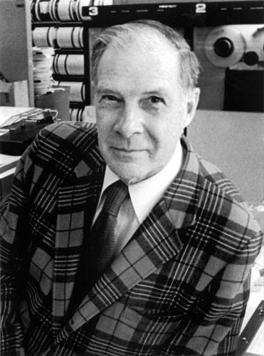
Richard Hamming
"Why do so few scientists make significant contributions and so many are forgotten in the long run?"
“If you don't work on important problems, it's not likely that you'll do important work.”
Richard W. Hamming, “You and Your Research”, March 7, 1986.

Slide 6
1. The 100 Year Test
Hamming once asked me,
“What progress of today will be remembered 1000 years from now ?”
Will your work be remembered 100 years from today?

Slide 7
2. The Modeling Process
Mathematical
Model of
The Real World
The
Real
World
Solution to the
Mathematical
Model

Slide 8

2. But Don’t Fall in Love With Your Model
Mathematical
Model of
The Real World
The
Real
World
Approximation
Solution to the
Mathematical
Model

Slide 9
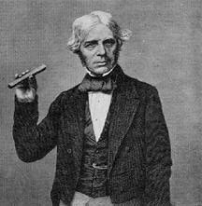
Michael Faraday
"I could not imagine much progress by reading only, without experimental facts and trials … I was never able to make a fact my own without seeing it. “ (Faraday: 1827)
Faraday performed in his brain the work of a great mathematician without using a single mathematical formula” (Hermann von Helmholtz : April 5, 1881 )

Slide 10
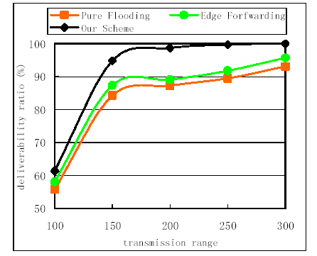
3. Beware of Mindless
Simulation

Slide 11
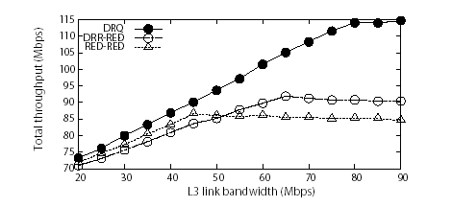
3. Beware of Mindless
Simulation

Slide 12
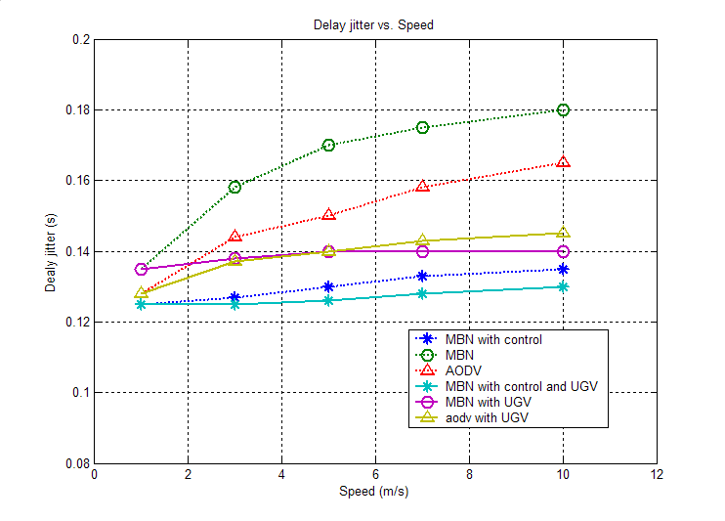
3. Beware of Mindless
Simulation

Slide 13
3. Beware of Mindless
Simulation

Slide 14
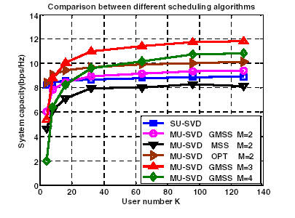
3. Beware of Mindless
Simulation

Slide 15
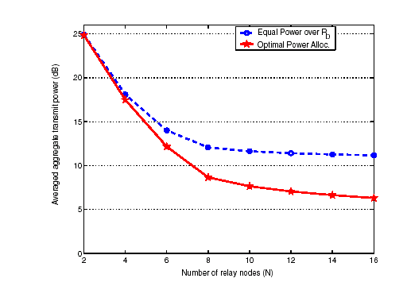
3. Beware of Mindless
Simulation

Slide 16
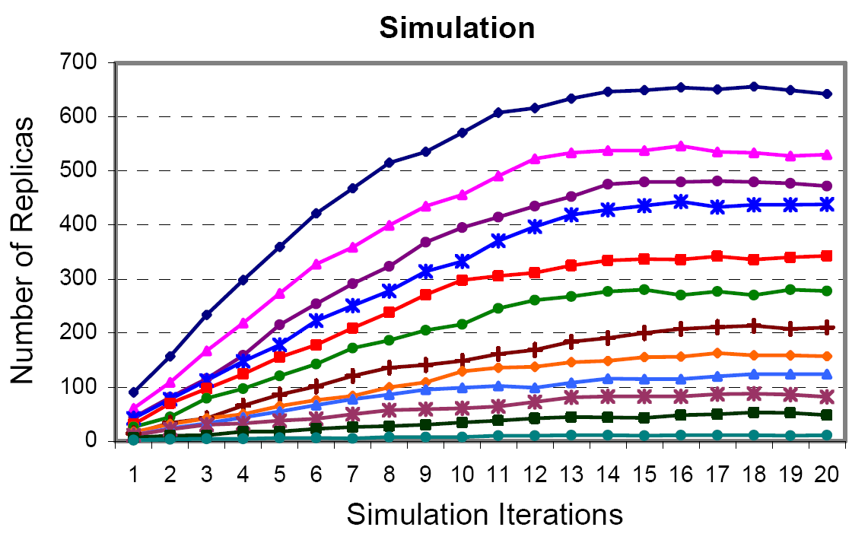
3. Beware of Mindless
Simulation

Slide 17
Ask the Obvious Questions
3. Beware of Mindless
Simulation
Asymptote
Slope
Intercept
Breakpoint

Slide 18
4. Understand Your Own Results

Slide 19

Response Time
Loss
RESPONSE TIME
T
Input
CAPACITY
0
LOSS
Network Cloud
Notes:
NEWare
Oct. 10, 1997
Nomadix Confidential

Slide 20
Response Time vs Throughput
Now let’s ask a good question:
Do you want
to operate
here?
T( )
Or here?
Response
  Time
( )
0
Throughput
Notes:
NEWare
Oct. 10, 1997
Nomadix Confidential

Slide 21
Response Time vs Throughput
4. Understand Your Own Results
Let me define a new metric of performance:
Throughput
POWER =
Response Time
T( )
P =
T( )
The main result
Power is
max when
Response
  Time
dT( )/d = T( )/
Max Power Point
1/P
( )
0
*
Kleinrock, L., "On Flow Control in Computer Networks", Conference Record, Proceedings of the International Conference on Communications, Vol. II, Toronto, Ontario, pp. 27.2.1 to 27.2.5, June 1978.
Throughput
Notes:
NEWare
Oct. 10, 1997
Nomadix Confidential

Slide 22
Response Time vs Throughput
4. Understand Your Own Results
We need a new metric of performance:
Throughput
POWER =
Response Time
T( )
P =
T( )
Response
  Time
Max Power Point
1/P
( )
0
*
Kleinrock, L., "On Flow Control in Computer Networks", Conference Record, Proceedings of the International Conference on Communications, Vol. II, Toronto, Ontario, pp. 27.2.1 to 27.2.5, June 1978.
Throughput
Notes:
NEWare
Oct. 10, 1997
Nomadix Confidential

Slide 23
Response Time vs Throughput
4. Understand Your Own Results
Let’s Dig Deeper on Understanding
For M/M/1
this gives
max Power at
N* = 1
Why ?
T( )
Response
  Time
Max Power Point
( )
0
*
Kleinrock, L., "On Flow Control in Computer Networks", Conference Record, Proceedings of the International Conference on Communications, Vol. II, Toronto, Ontario, pp. 27.2.1 to 27.2.5, June 1978.
Throughput
Notes:
NEWare
Oct. 10, 1997
Nomadix Confidential

Slide 24
4. Understand Your Own Results
Use Your Intuition
T
T
= Min
Eff = Max
Notes:
NEWare
Oct. 10, 1997
Nomadix Confidential

Slide 25
4. Understand Your Own Results
Use Your Intuition
Only 1 customer
in the system
Insight:
Just keep the
pipe full!
T
T
= Min
Eff = Max
Notes:
NEWare
Oct. 10, 1997
Nomadix Confidential

Slide 26
4. Understand Your Own Results
Our intuition says put exactly one person in the queueing system
  This was from “deterministic” reasoning.
We can’t actually do that in general
BUT our earlier result said that we should adjust the system to achieve an average of one person in the queueing system, i.e.,
At Max Power
N* = 1
for M/M/1

Slide 27
5. Gee, that’s funny!

Slide 28
5. Gee, that’s funny!
What can we say for M/G/1 ?
M/G/1
N*=1
M/M/1
T( )
0
Notes:
NEWare
Oct. 10, 1997
Nomadix Confidential

Slide 29
More on Modeling
Moving the frontier is tough
(we mislead our students)
Once you do it, you will be able to repeat it (students don’t believe us)
Teach your students to understand their results!
Generalization usually comes when you can see the simplicity of a solution
Keep your interest in related areas - areas where something might happen.

Slide 30
Thank You
www.lk.cs.ucla.edu
Notes:
NEWare
Oct. 10, 1997
Nomadix Confidential

